Slide 1
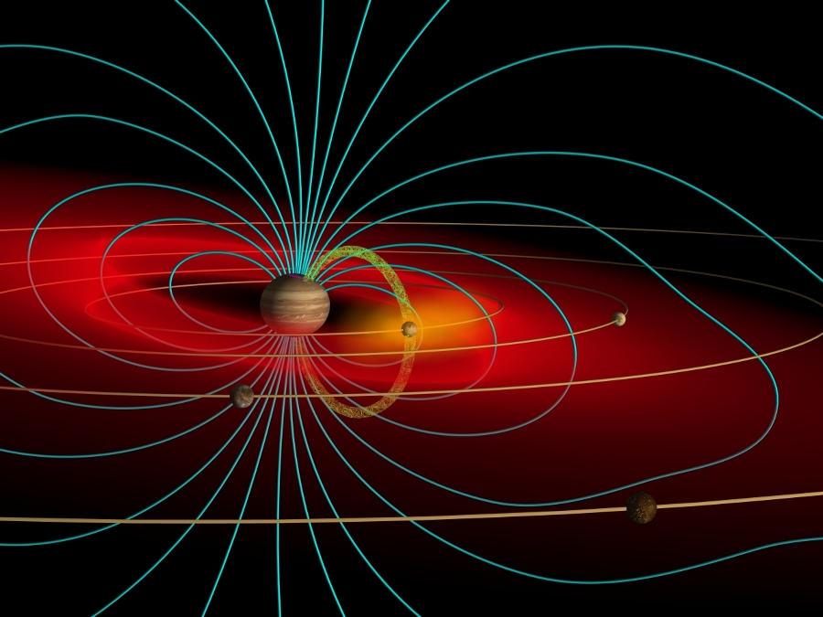


Io’s Escaping Atmosphere and Plasma Torus
Carl Schmidt
Hisaki Team Visit 2018

Slide 2
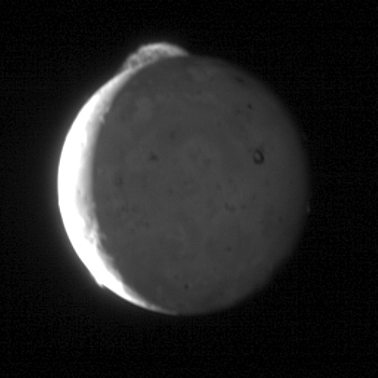
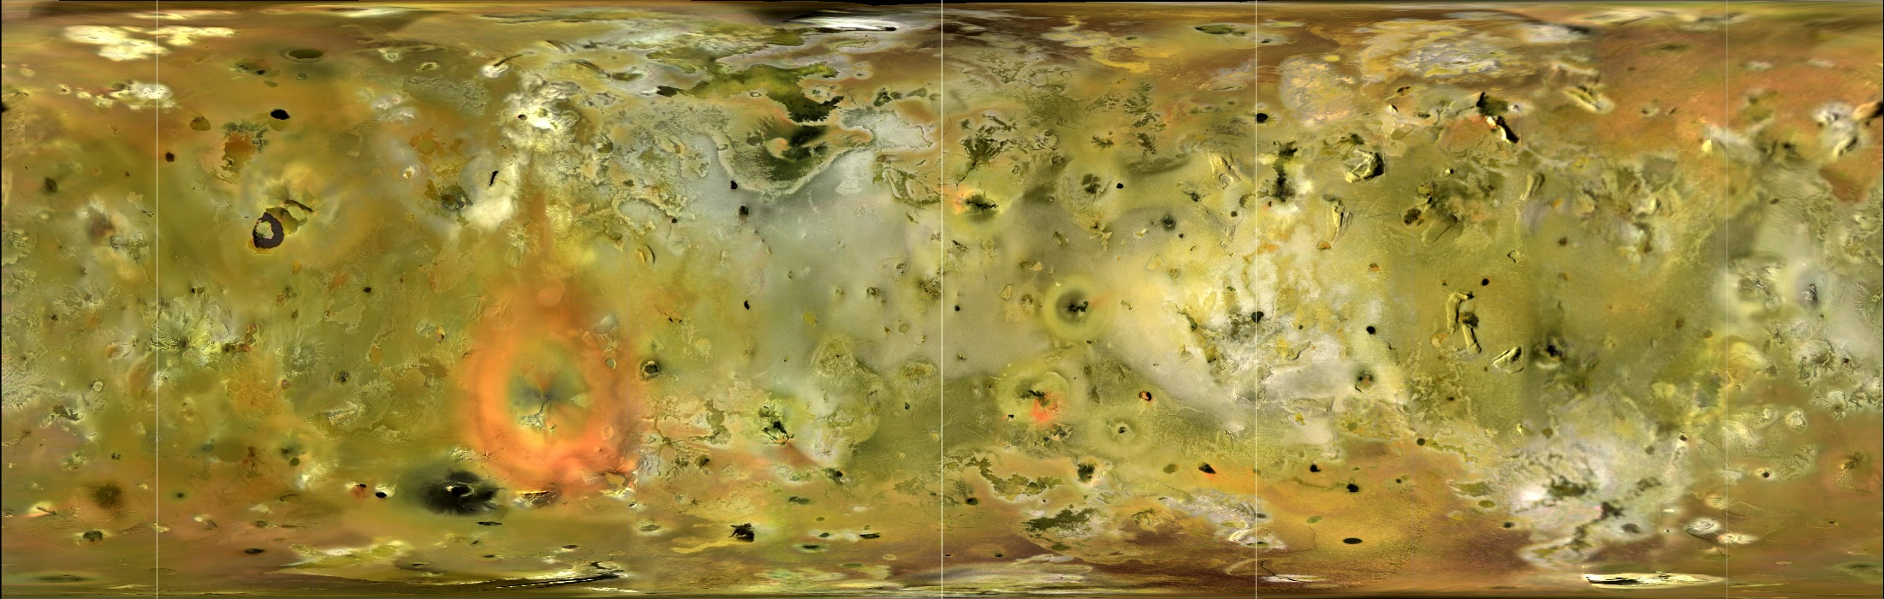
Io: Jupiter’s Volcanic Moon
∙ Tidal heating drives 200+ active volcanic sites
∙ Volcanic plumes create localized atmospheres.
∙ 1 Ton/s atmospheric loss. Mostly SO₂. Sublimation or plumes? Plume composition variable?
∙ e- impacts create pickup ions, supplies Jupiter’s magnetosphere. Neutral clouds or direct Io source?

Slide 3
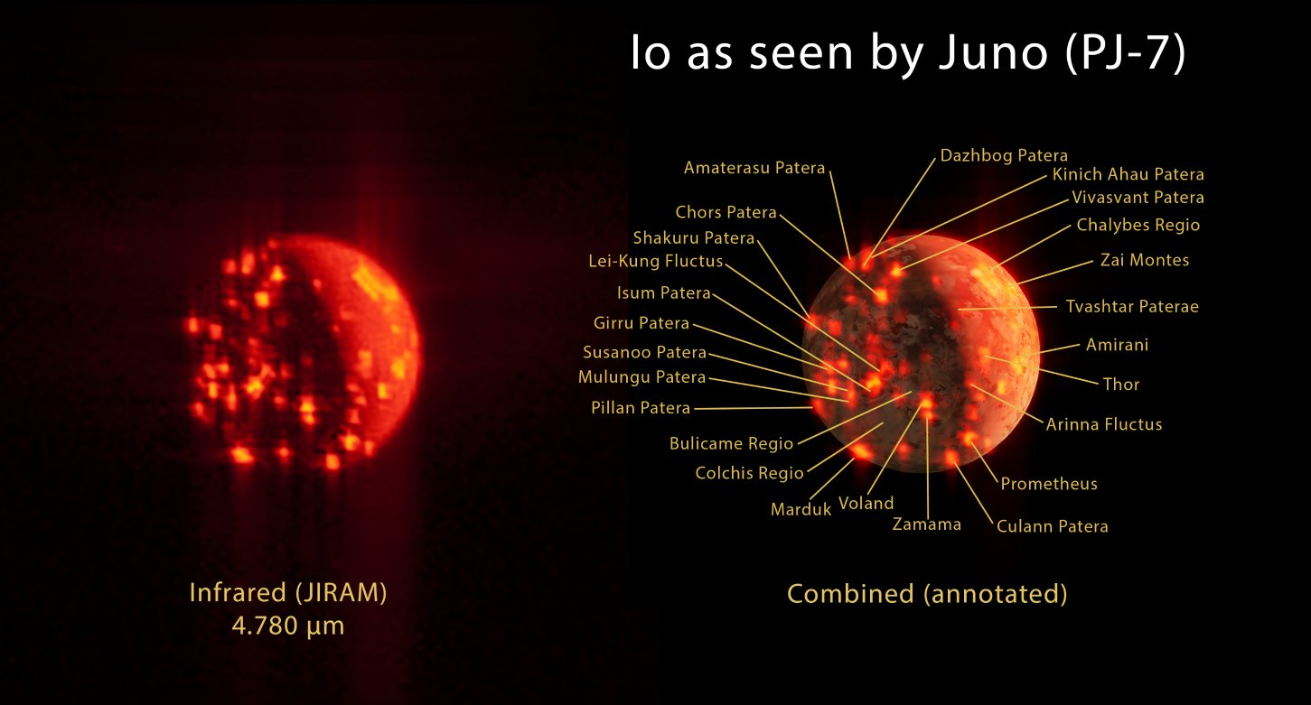

Slide 4
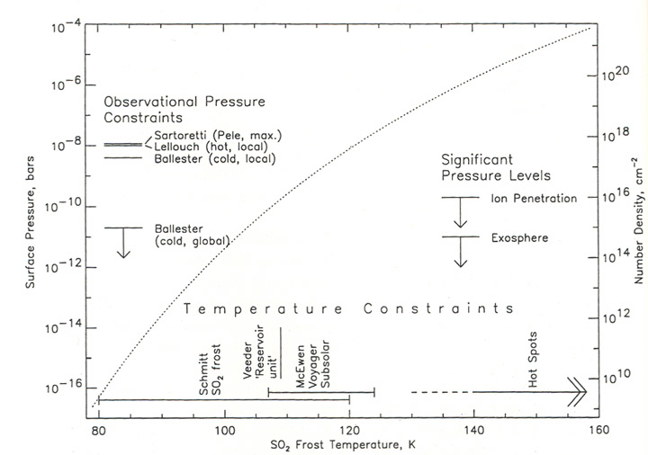
SO₂ Atmosphere: Diurnal Cycle
Lellouch (1996)
Huge temp dependence. Diurnal changes ~10⁶, local hot spot atmospheres.

Slide 5

Eclipses: Natural Laboratories
Thermal continuum 2.3 µm
Skrutskie, Nelson & Schmidt (DPS 2016)
Montanes-Rodriguez et al. (2015)
Max duration is ~1 hour at quadrature.
Visible/UV atom & ion emission: hard--blind offsets, moving targets, egress
IR molecules & volcanic continuum: easy--Io’s self-luminous beyond 1.7µm

Slide 6
Eclipses: Natural Laboratories
Convincing evidence that the S0₂ atmosphere is supplied by…
sublimation not volcanism.
volcanism not sublimation.
Tsang et al., 2016
Spencer et al. (LPSC 2012)
Saur & Strobel model
emission response

Slide 7
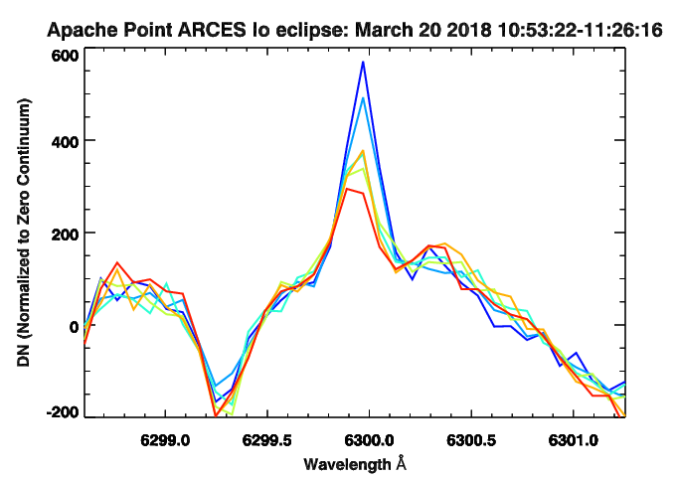
Behavior at Bed-time:
Molecules FAST
Tsang et al., 2016
Tvashtar?
ΔT_{e-}?
Atoms SLOW
Retherford et al., 2007
Ultra-Violet
Visible

Slide 8
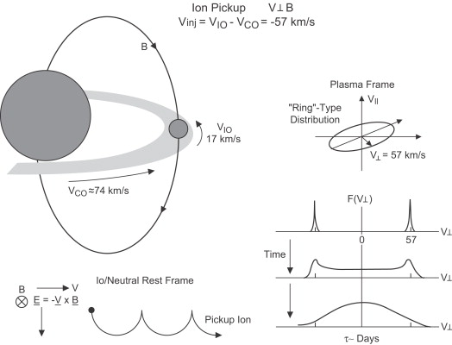
What happens if this gas is ionized?
Russell & Blanco-Cano (2007)
Feedback

Slide 9
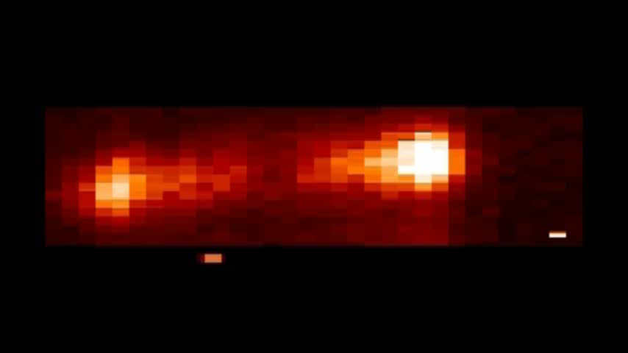
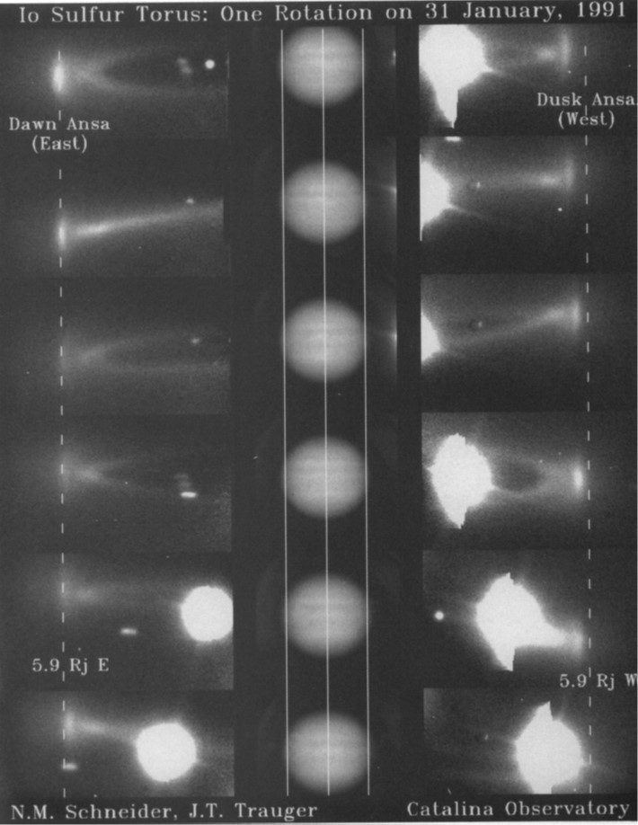



Emissions in Io’s Plasma Torus
Cassini 834Å (A. Steffl & I. Stewart)
Dawn
Dusk
$$4πI=\int{A_{ji}f_{j}\left(T_{e},n_{e}\right)n_{i}}dl$$
EUV:
$$T_{e}≥9 to 20 eV$$
Visible:
$$T_{e}≥1.8 to 3.3 eV$$
Jupiter & moons much brighter.
Cold torus structure
S⁺ Visible Wavelengths

Slide 10
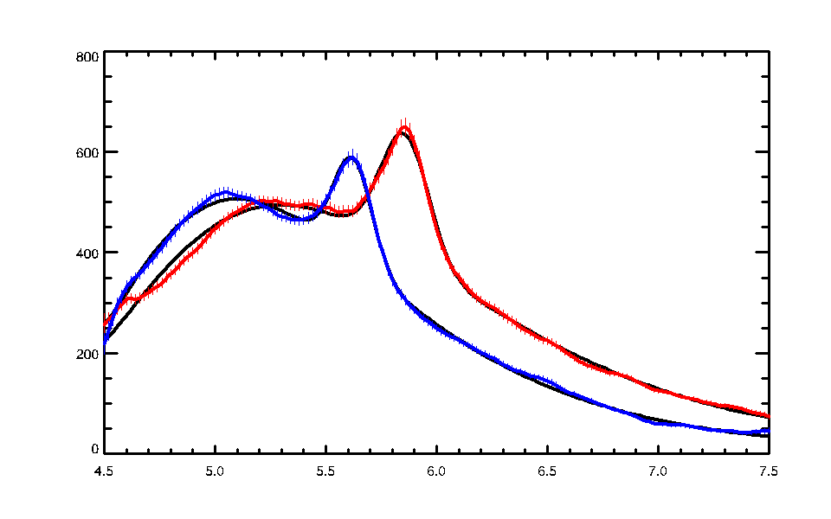
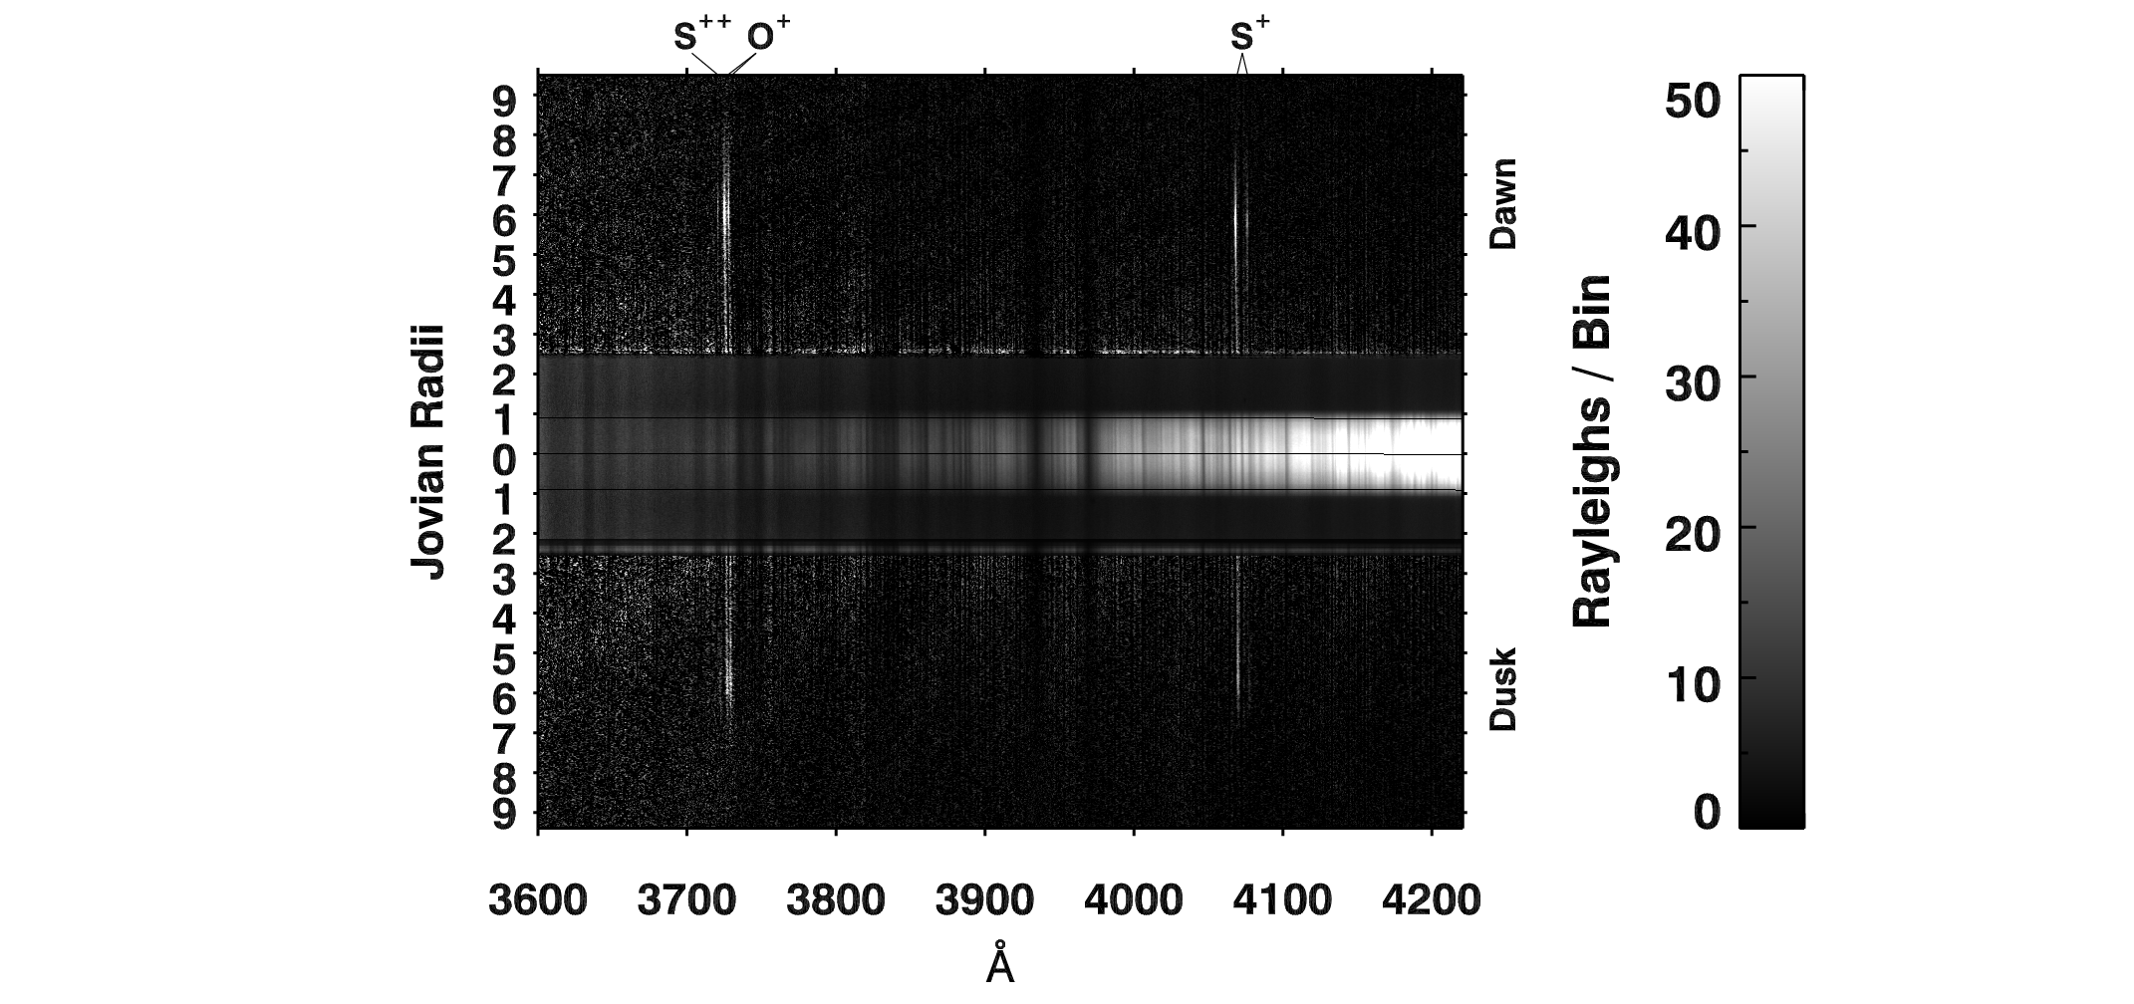
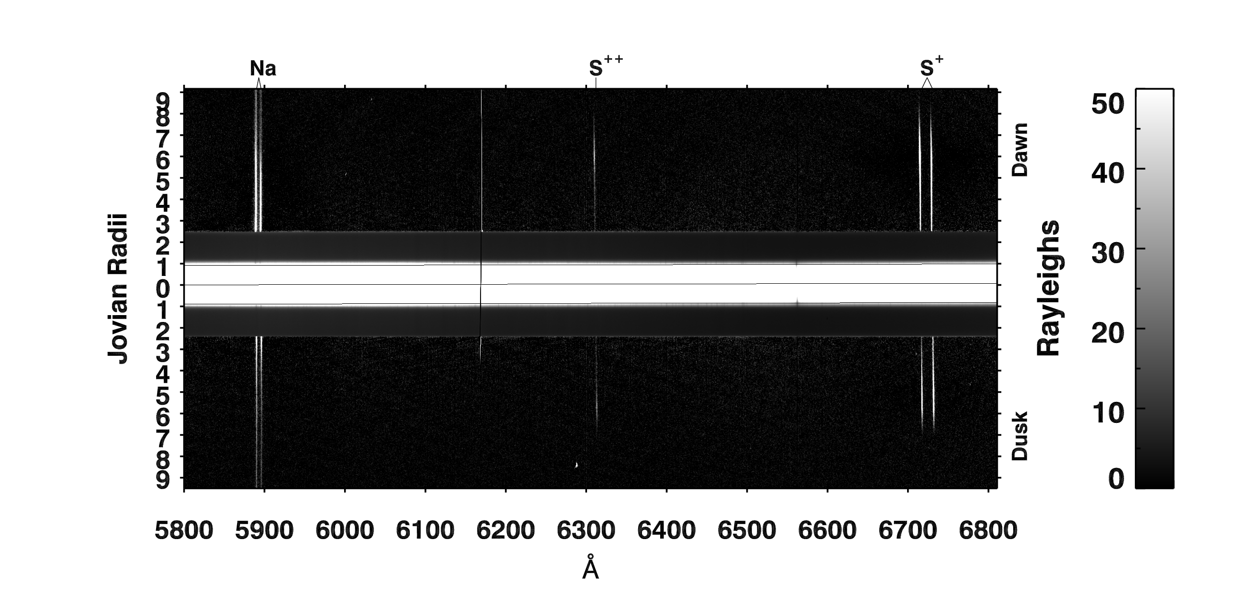
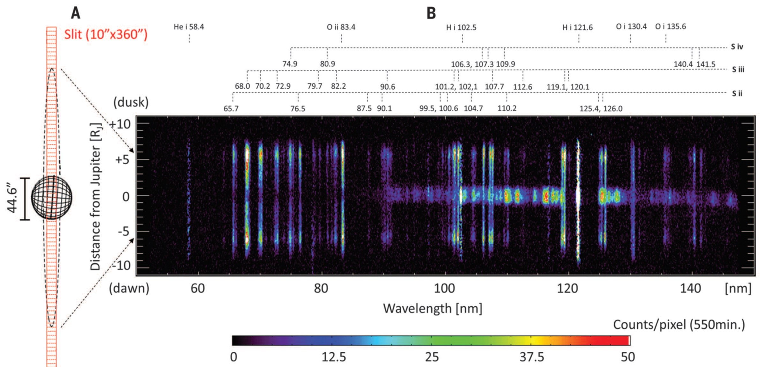
Dawn
Dusk
Schmidt+ 2018
Yoshioka+ 2014

Slide 11
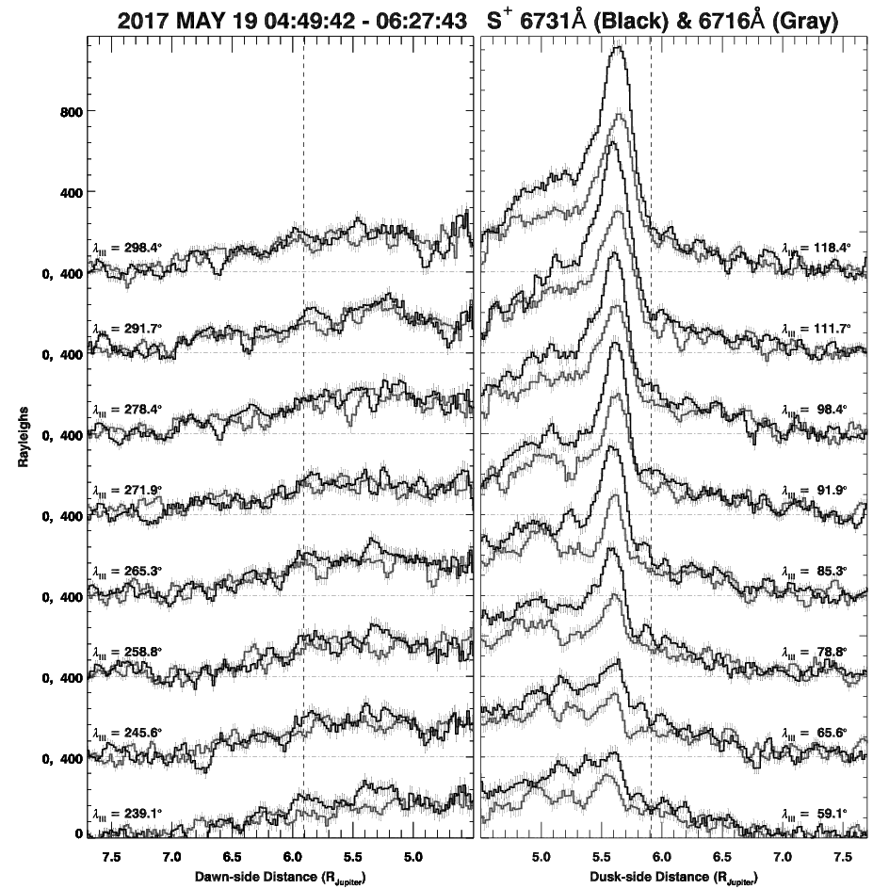
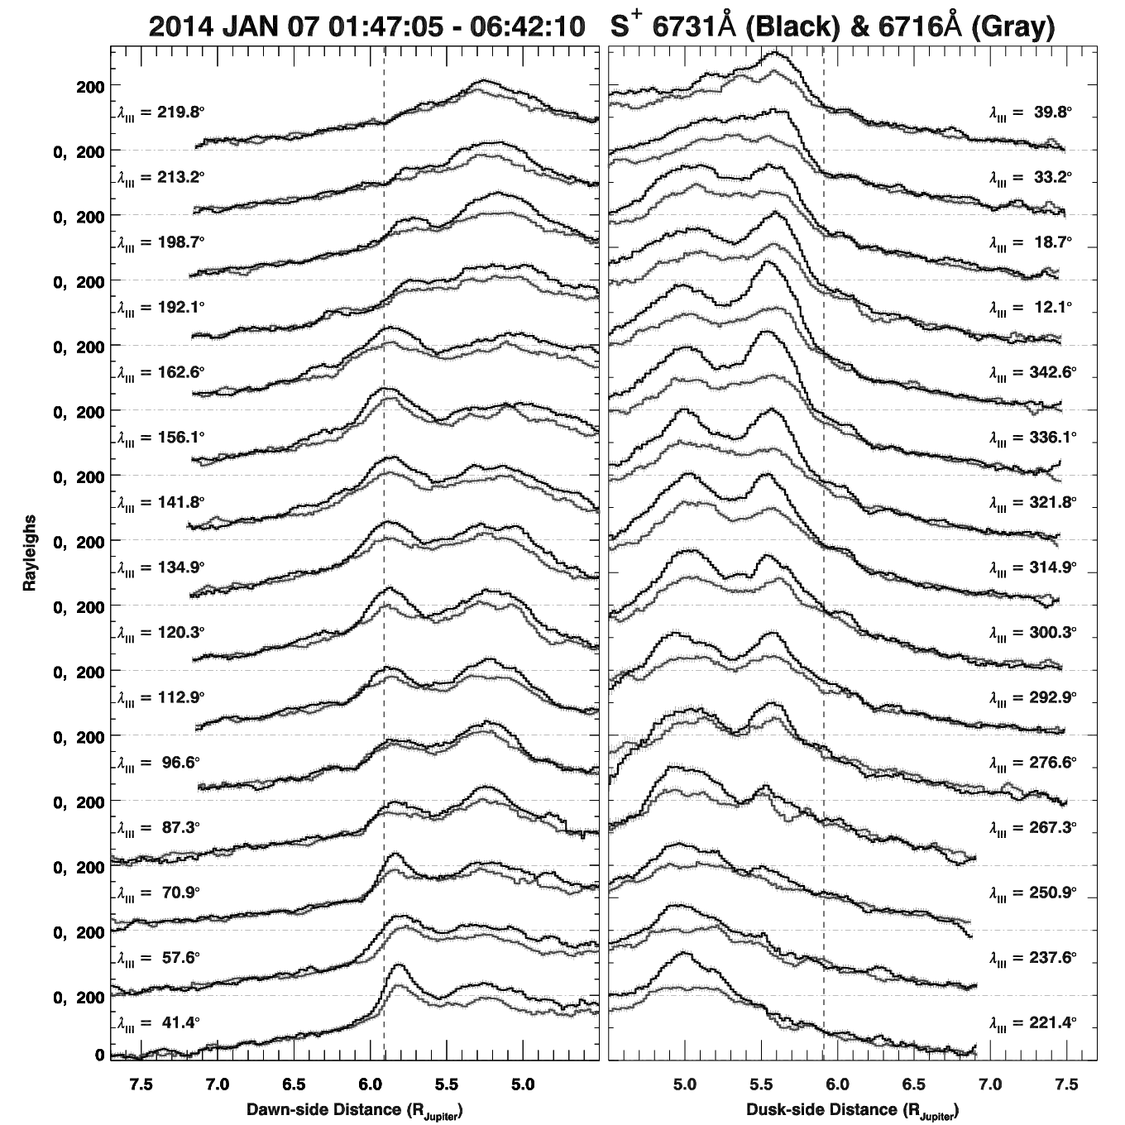
5 hours of observation maps radial and azimuthal structure…
∙ Dawn / Dusk
∙ Ribbon Width
∙ Ribbon Location
∙ S⁺, S⁺⁺, O⁺ radiance

Slide 12
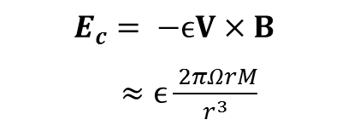
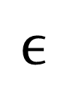
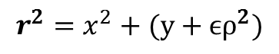
Hisaki EUV Brightness Asymmetry
Sandel & Broadfoot 1982
Implied offset
$$ϵ$$
Barbosa & Kivelson 1983
$$r^{2}=x^{2}+(y+{ϵρ}^{2})$$
$$E_{c}= −ϵV×B$$
$≈ϵ\frac{ 2πΩrM}{r^{3}}$
Ip & Goertz 1983
Murakami+ 2016

Slide 13
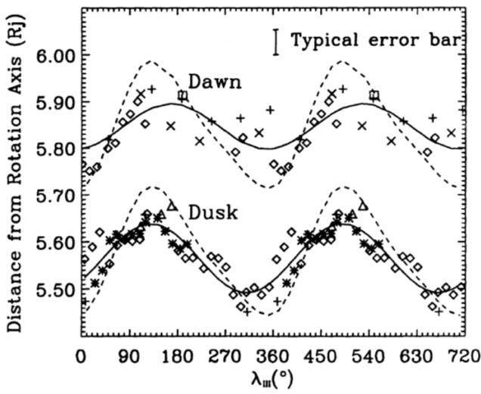
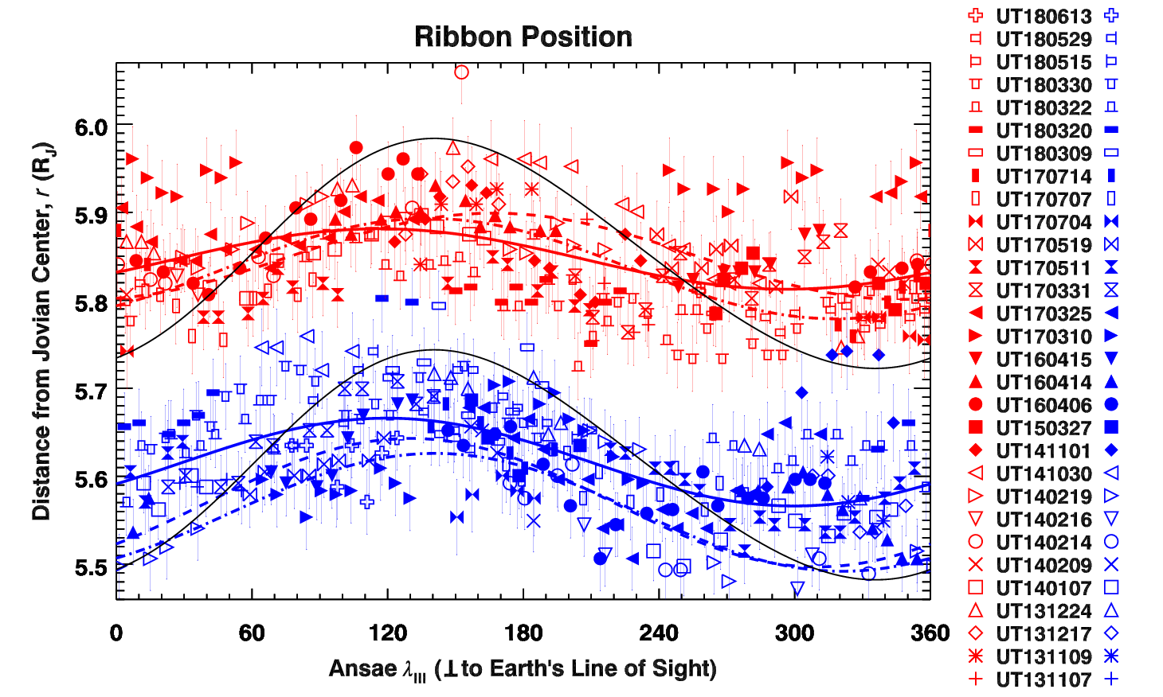
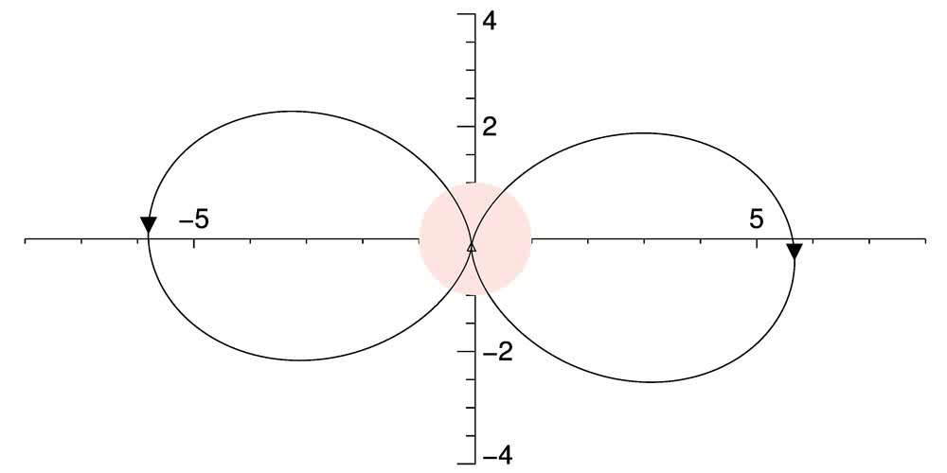
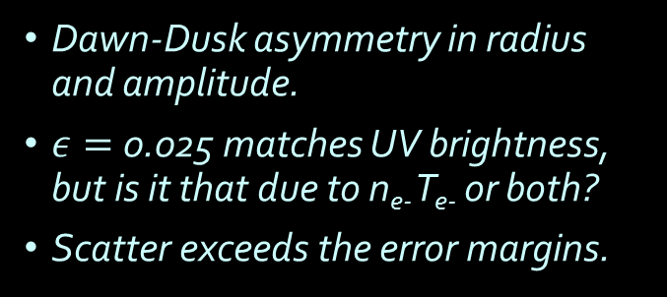
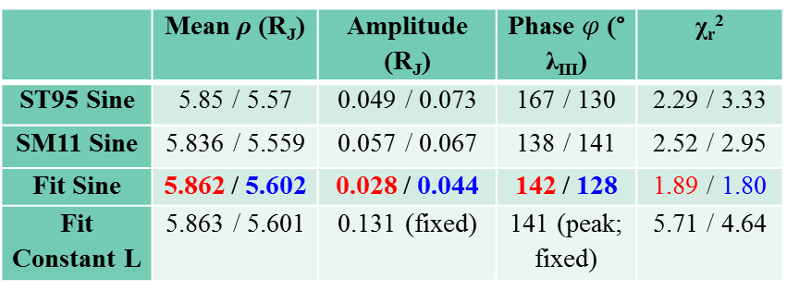
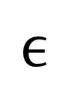
Dawn-Dusk Offset & Wobble Motion
Schneider & Trauger 1995
Schmidt+ 2018
$$ϵ$$
 | Mean ρ (R_{J}) | Amplitude (R_{J}) | Phase $φ$ (° λ_{III}) | χ_{r}²
ST95 Sine | 5.85 / 5.57 | 0.049 / 0.073 | 167 / 130 | 2.29 / 3.33
SM11 Sine | 5.836 / 5.559 | 0.057 / 0.067 | 138 / 141 | 2.52 / 2.95
Fit Sine | 5.862 / 5.602 | 0.028 / 0.044 | 142 / 128 | 1.89 / 1.80
Fit Constant L | 5.863 / 5.601 | 0.131 (fixed) | 141 (peak; fixed) | 5.71 / 4.64
Dawn-Dusk asymmetry in radius and amplitude.
$ε=$0.025 matches UV brightness, but is it that due to n_{e-} T_{e-} or both?
Scatter exceeds the error margins.
Densest region interacts with Io under specific criteria: Dawn LT, 130° λ_{III}

Slide 14
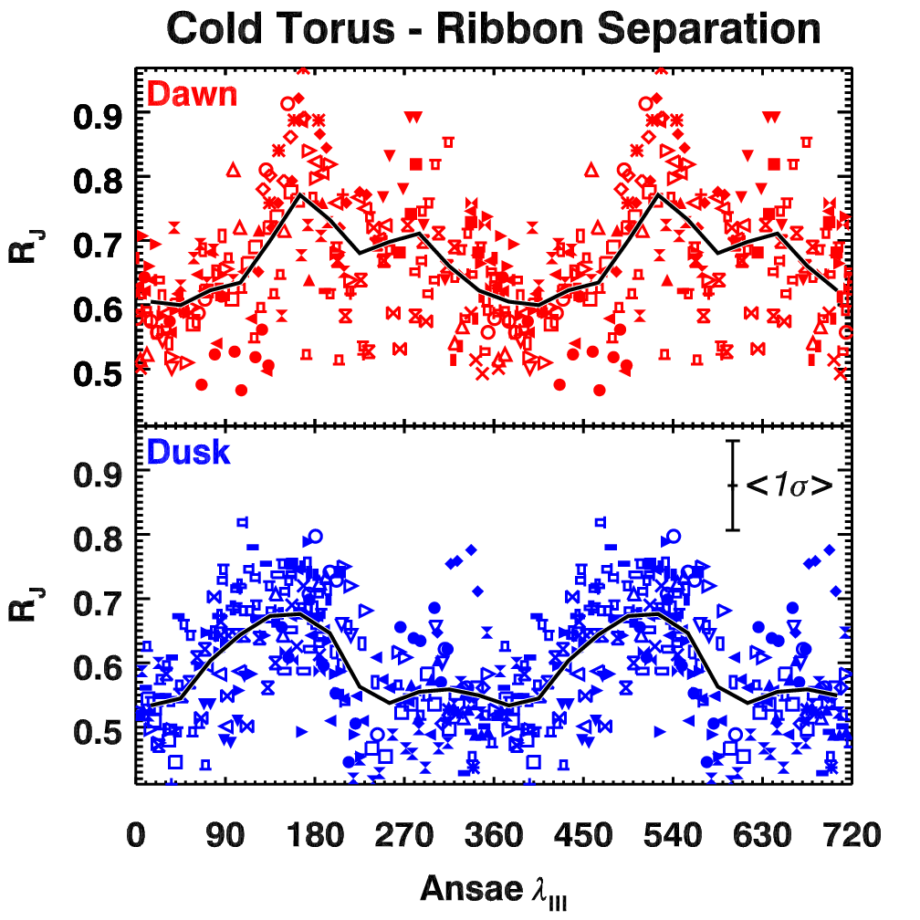
Cold Torus Wobble Motion
Horizontal offset
Herbert et al. (2008)
Schmidt et al. (2018)
Cold torus and the ribbon have different wobbling motion

Slide 15
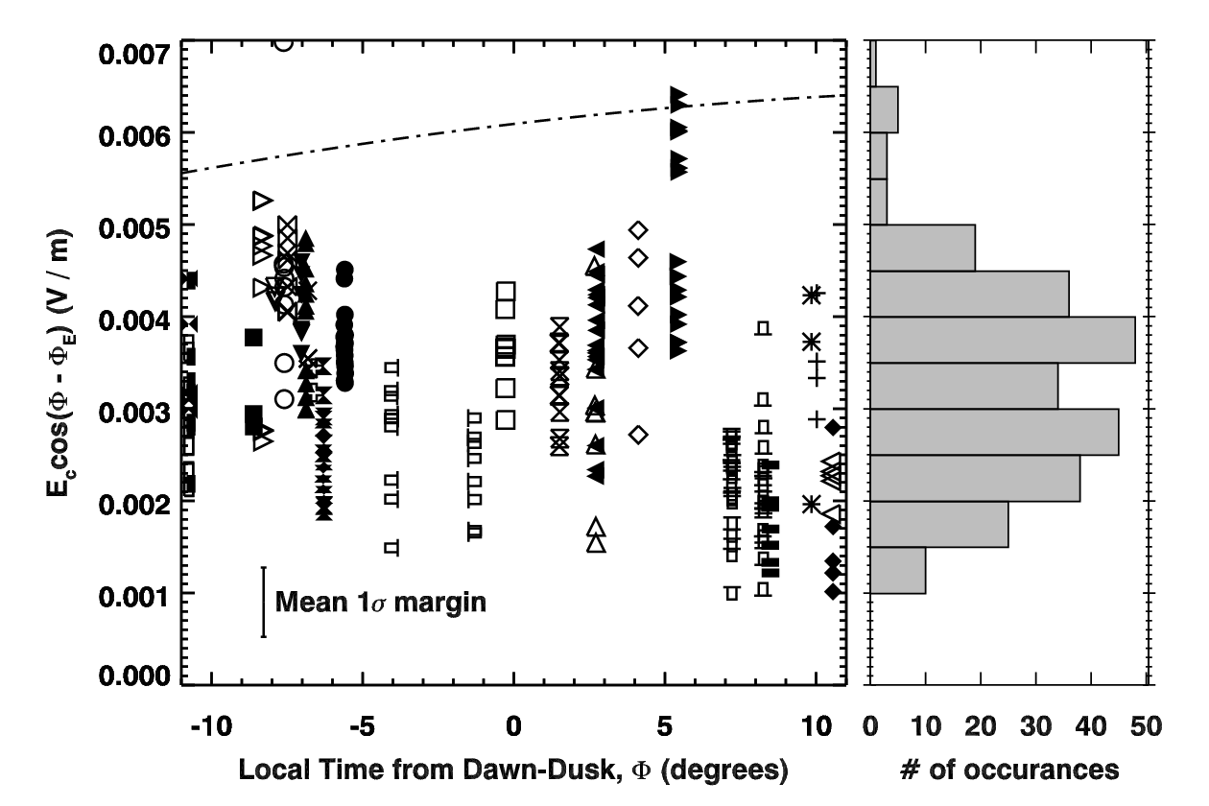
E-Field Magnitude & Orientation
E_{c} = 3.8 mV / m, φ ~ -10°
Smyth+ 2011
Voyager 1 & Galileo J0
E_{c} = 6.5 mV/m
φ = +20°
E-Field is variable - average direction from parallax is imprecise.
Vogt+ 2014

Slide 16
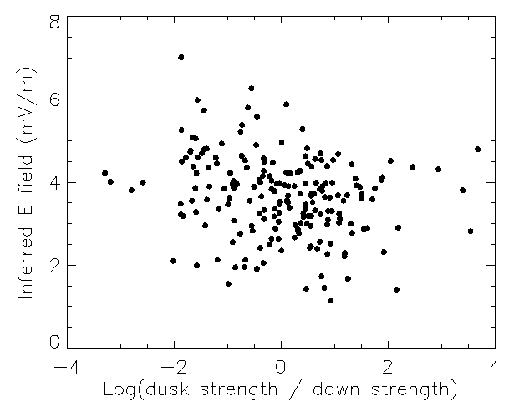
Unlike the expected UV relation, no correlation between E and Dawn/Dusk…
Hisaka Data
APO Data
Murakami+ 2016
→ Dawn/dusk brightness asymmetry is driven by adiabatic heating,
not by plasma density.

Slide 17
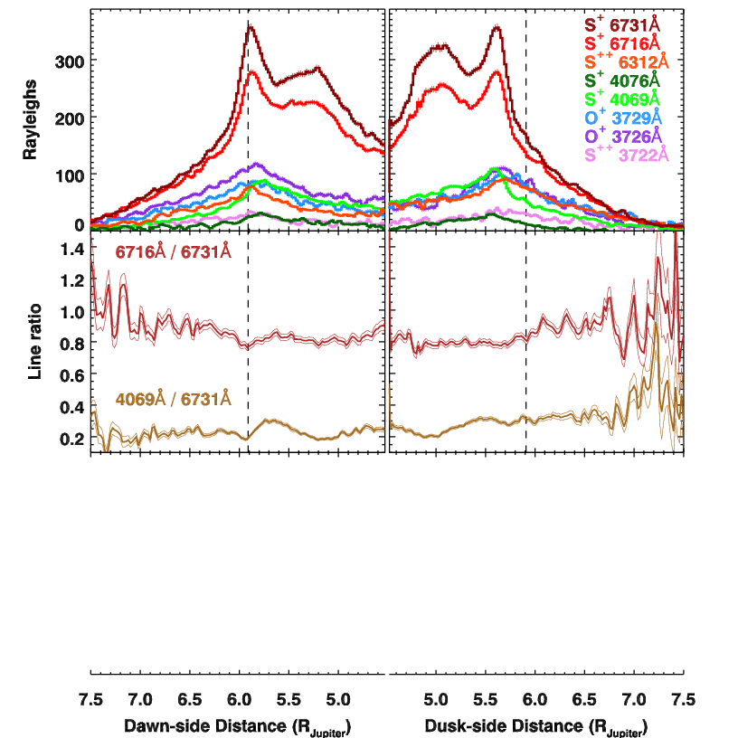

T_{e-} & n_{e-} Retrieval from Emission Profiles
Collisional & Radiative Equilibrium
Einstein A_{ji} and state degeneracy give line ratios.
e- impacts yield collisional excitations / de-excitations.
$$4πI=\int{A_{ji}f_{j}\left(T_{e},n_{e}\right)n_{i}}dl$$
How to treat line of sight?

Slide 18
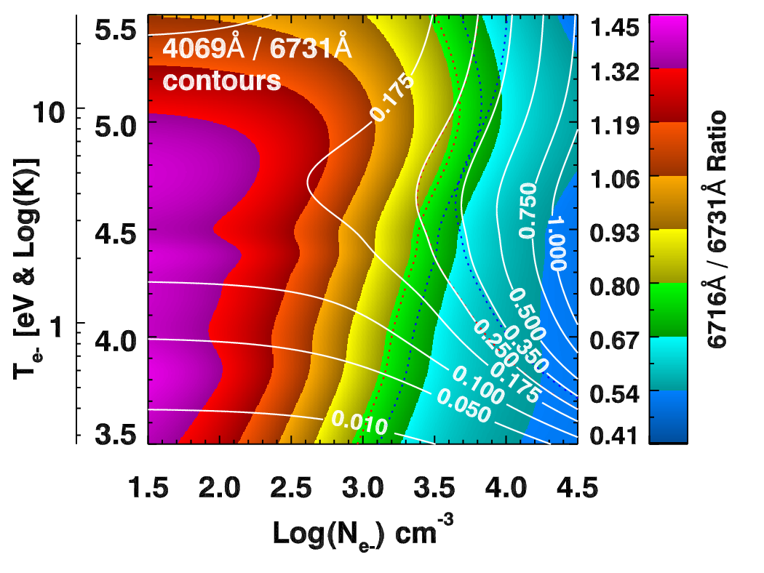

T_{e-} & n_{e-} Retrieval from Emission Profiles
Collisional & Radiative Equilibrium
Einstein A_{ji} and state degeneracy give line ratios.
e- impacts yield collisional excitations / de-excitations.
$$4πI=\int{A_{ji}f_{j}\left(T_{e},n_{e}\right)n_{i}}dl$$
How to treat line of sight?

Slide 19
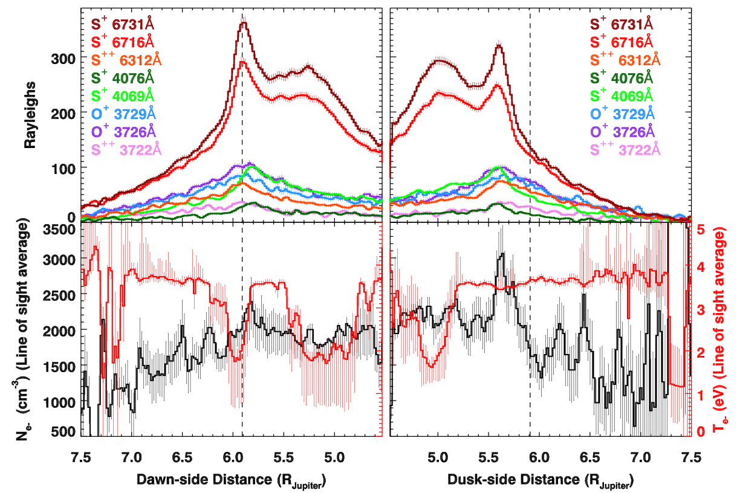
Method 1: C0-add & Ignore LOS
No assumptions needed
Good extraction SNR
Ignores n_{e} and T_{e} LOS
Fit or assume effective path?

Slide 20
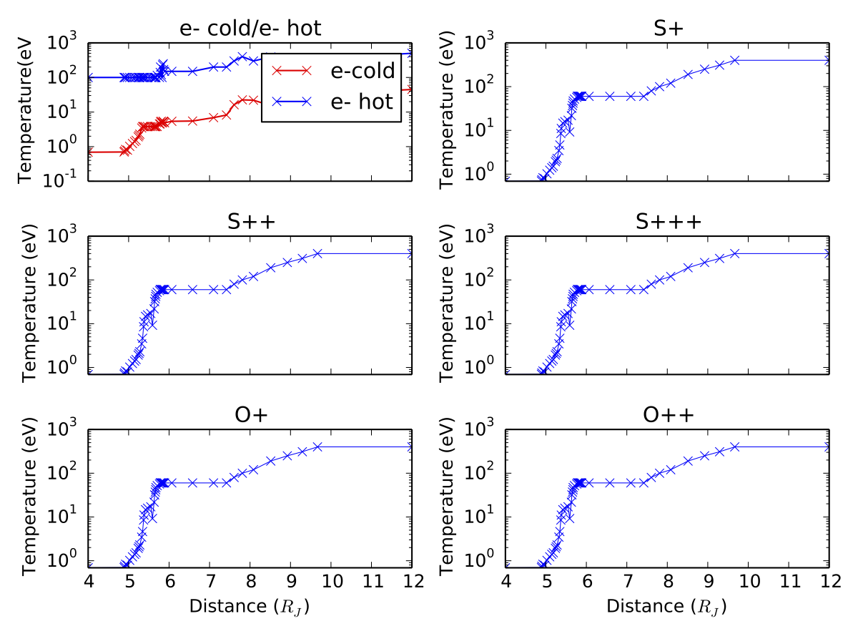
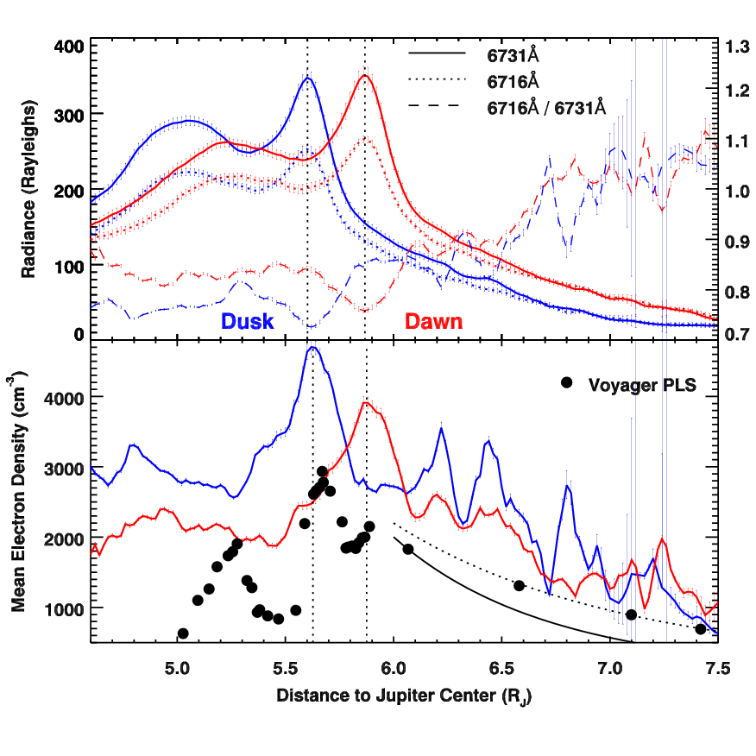
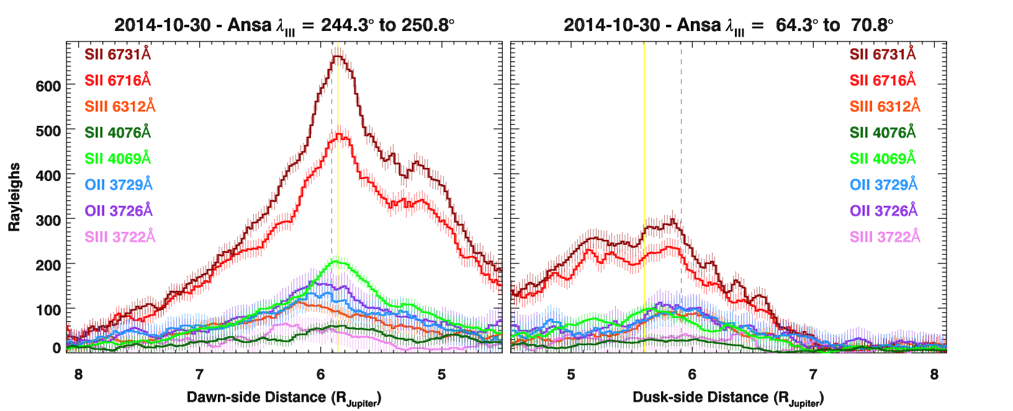
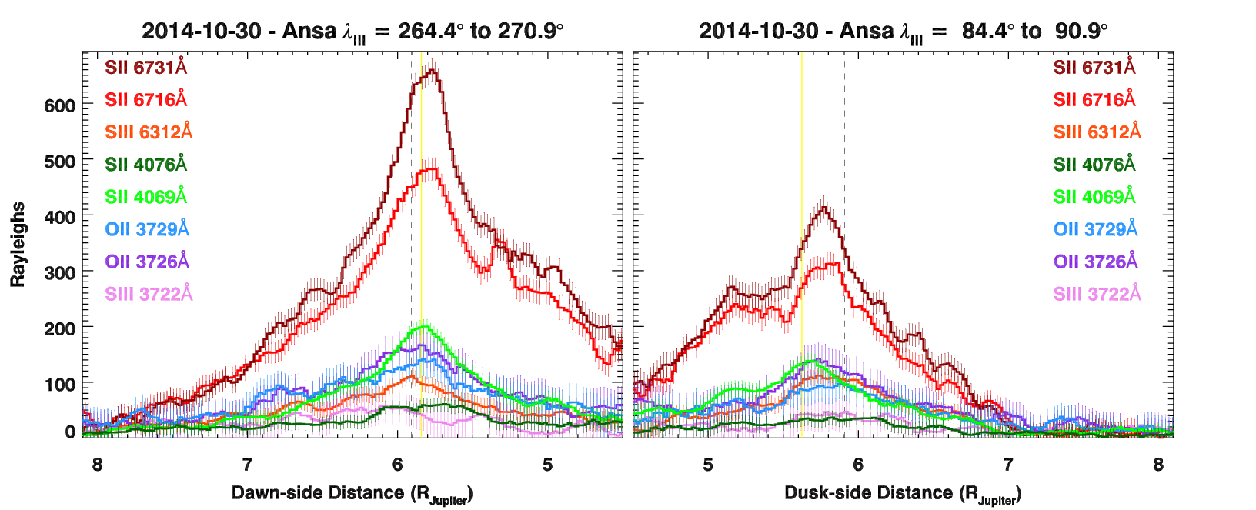
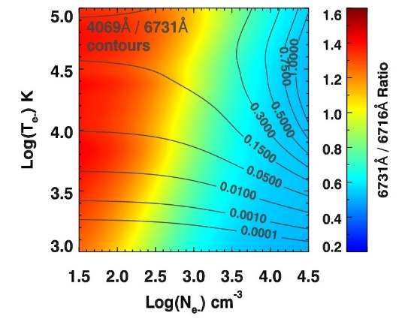
Method 2: Assume in situ T_{e}
Some structure
6-7 R_{J} is real.
What is it?
Bagenal, 1994
Not strictly self-consistent
Combats LOS effects
Mean n_{e-} is between Galileo and Voyager.
Dusk denser, narrower
n_{e-} and S⁺ peaks offset
21 / 27
Method 3: Kagitani-san’s Inverse Abel: TBD

Slide 21
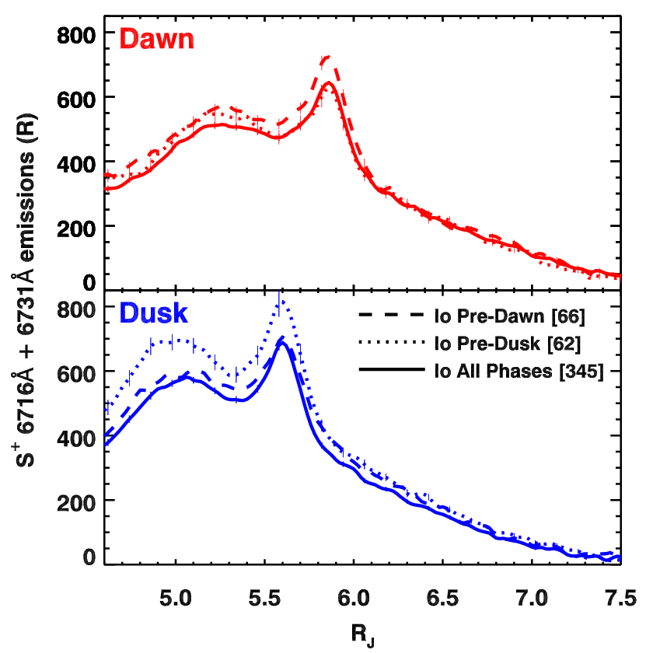
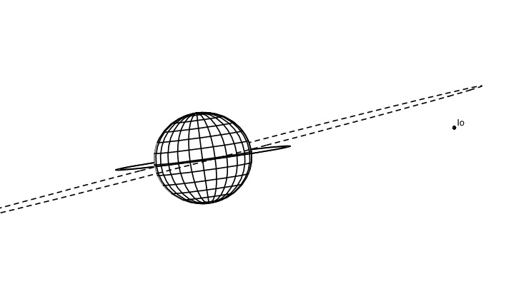
Hisaki vs Optical: Brightness with Io Phase
Io’s period
Tsuchiya+ 2015
Brown (1995)
∙ Narrow slit widths can resolve an Io phase effect, but only near 20° & 200° λ_{III}
∙ Io phase modulates the ribbon and cold torus brightness, rapid inward diffusion?

Slide 22
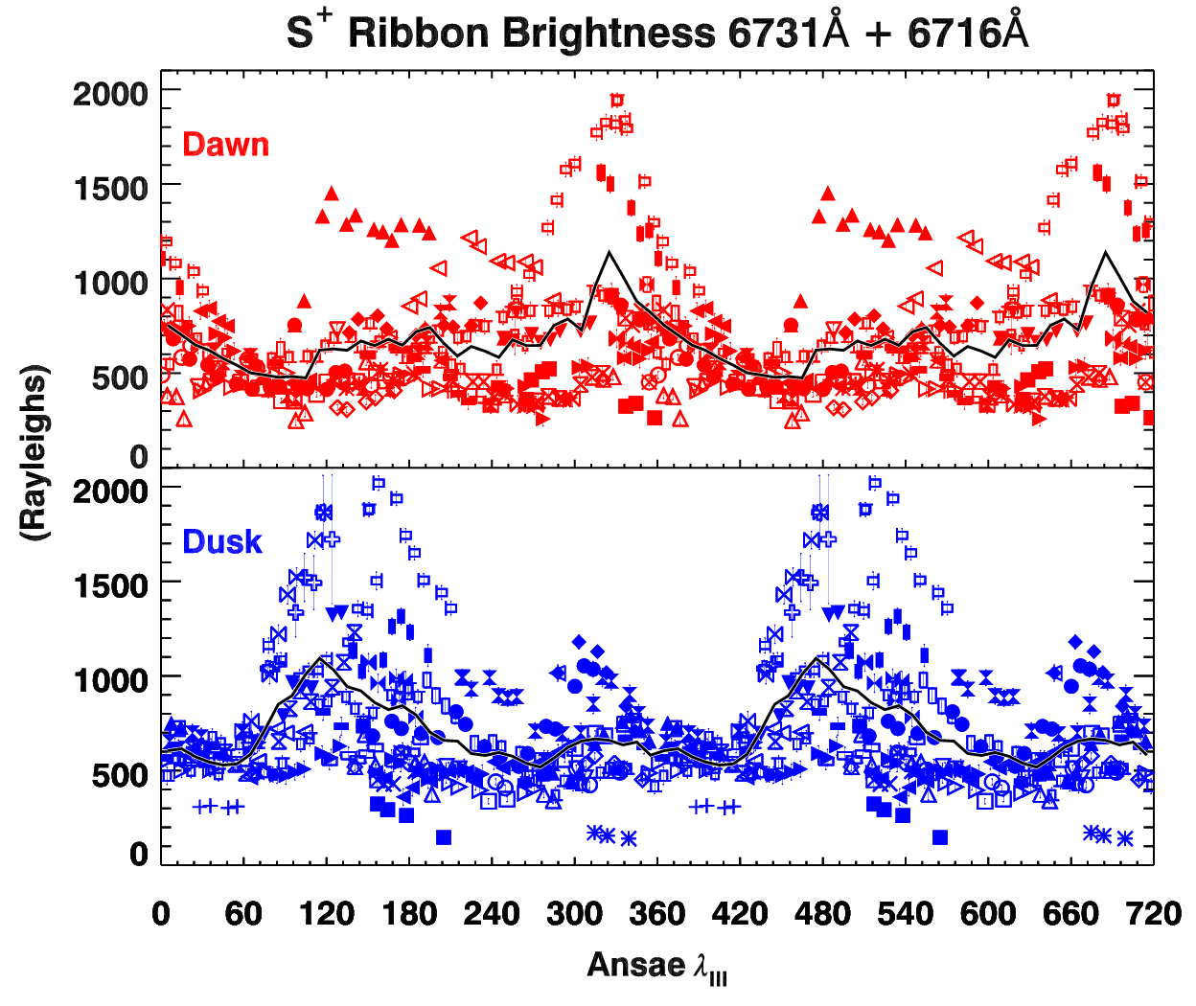
Brightness with Jovian Longitude
Projection effects would give brightness maxima at 20° & 200° λ_{III}
Schneider & Trauger 1995
Brown 1995
Dawn
Dusk
Tsuchiya+ 2015
Schmidt+ 2018
No “active region”. Maxima near torus & satellite plane intersect.

Slide 23
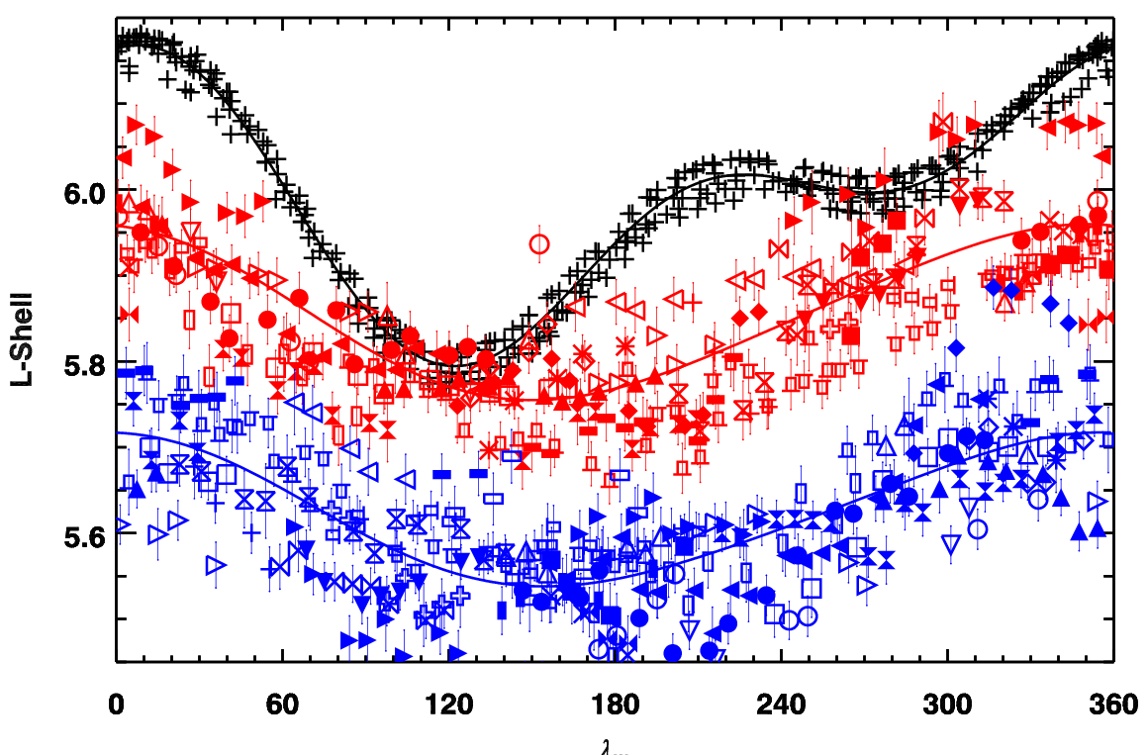
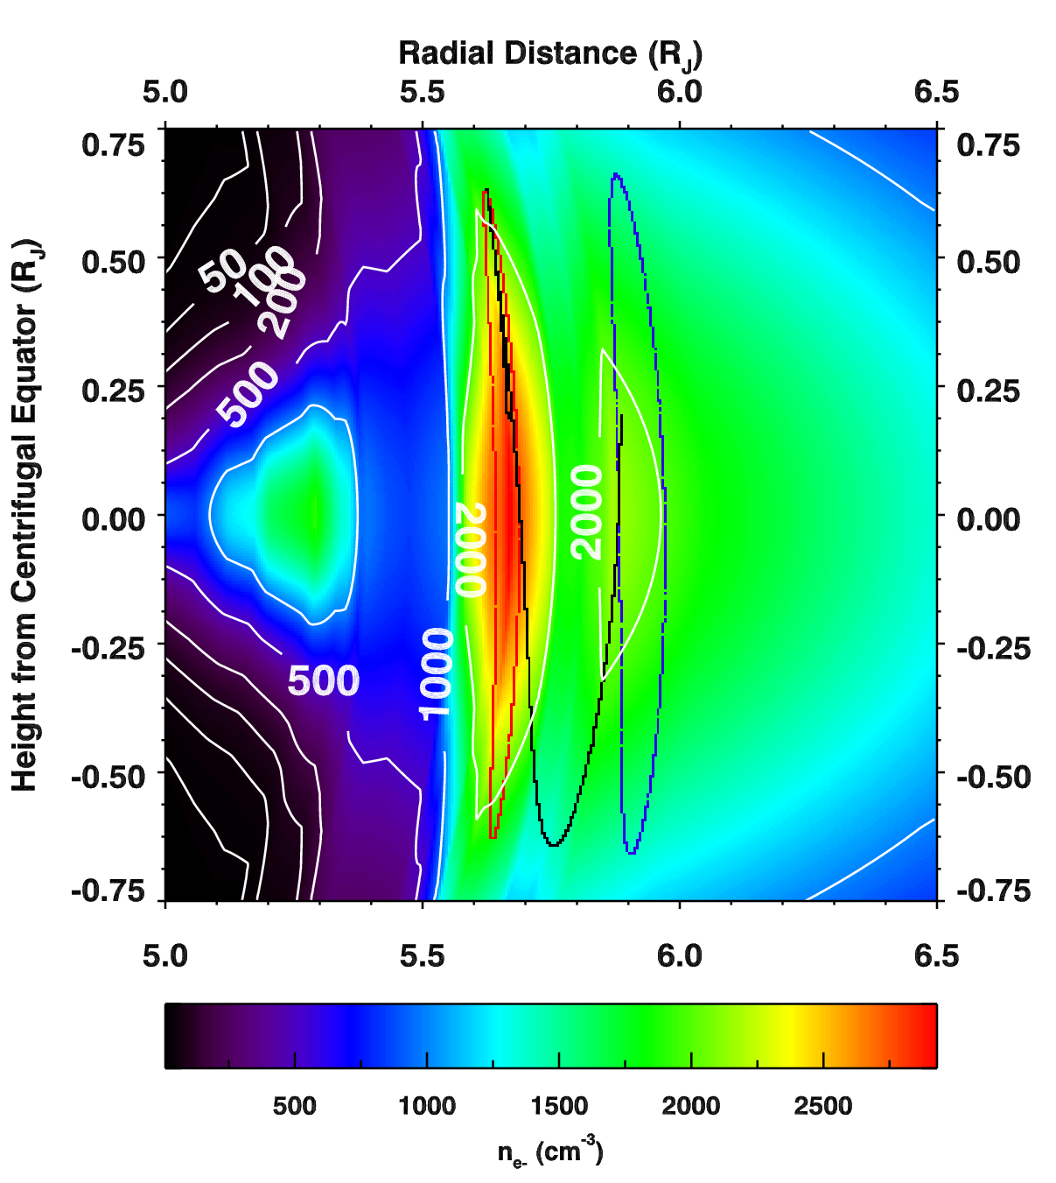
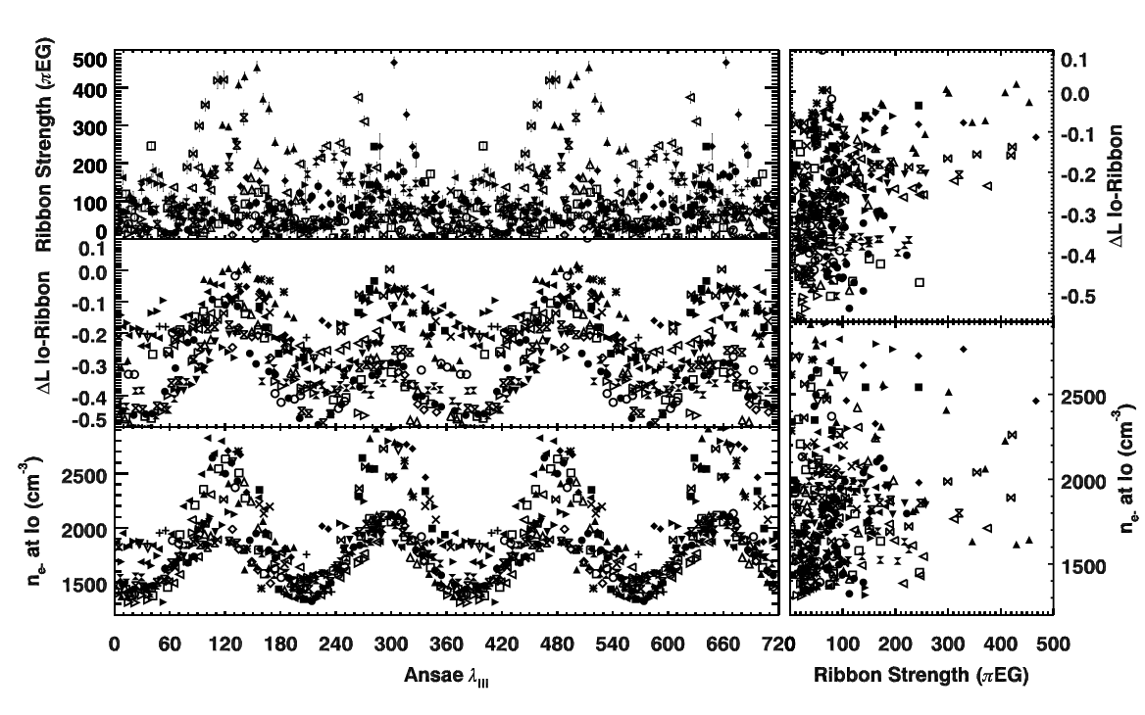
Drivers with Jovian Longitude
Io’s last passage (+)
OI 6300Å
Bonfond+ 2013
Wannawichian+ 2013
Io Footprint H₂
Dawn
Dusk
Oliversen+
2001
ΔL between Io & Ribbon at conjunction
n_{e-} at Io at conjunction

Slide 24
Why are these correlations so bad? Asynchronous Drivers:
Io’s period
Brown (1995)
Brown (1995)
Thomas et al. (2001)
λ_{III} x λ_{IV} beat frequency is weeks. λ_{IV} drifts with volcanism, so we can’t tag its phase, but if volcanic drivers are complicating our search for periodic brightness drivers, maybe the neutral emissions can help?

Slide 25
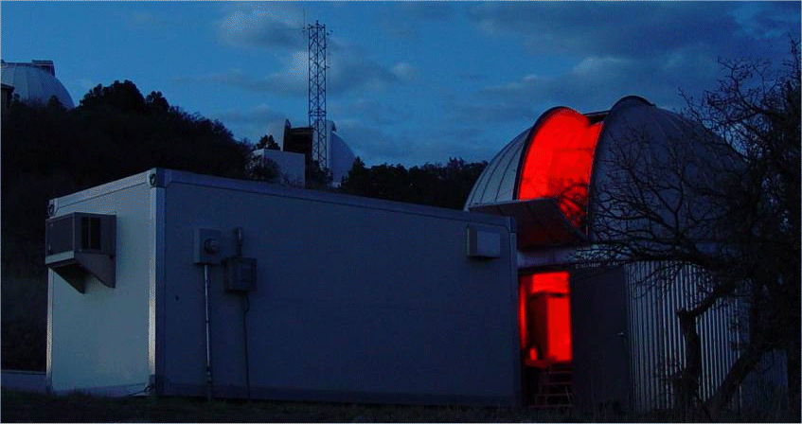
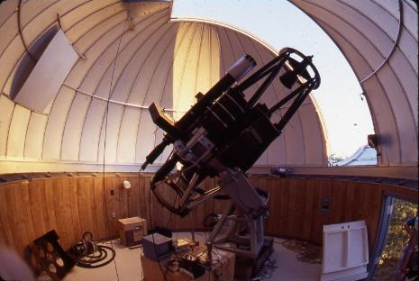
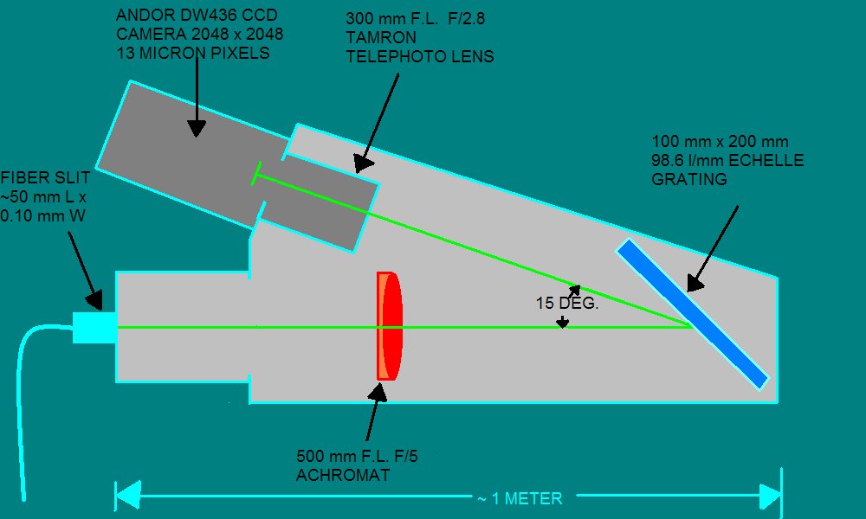
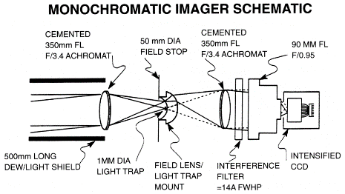
Neutrals? -> McDonald Observatory
Image-Slicing Spectrograph
Wide-Field Coronagraph
2.7’ x 1.8’ FOV
7° FOV

Slide 26
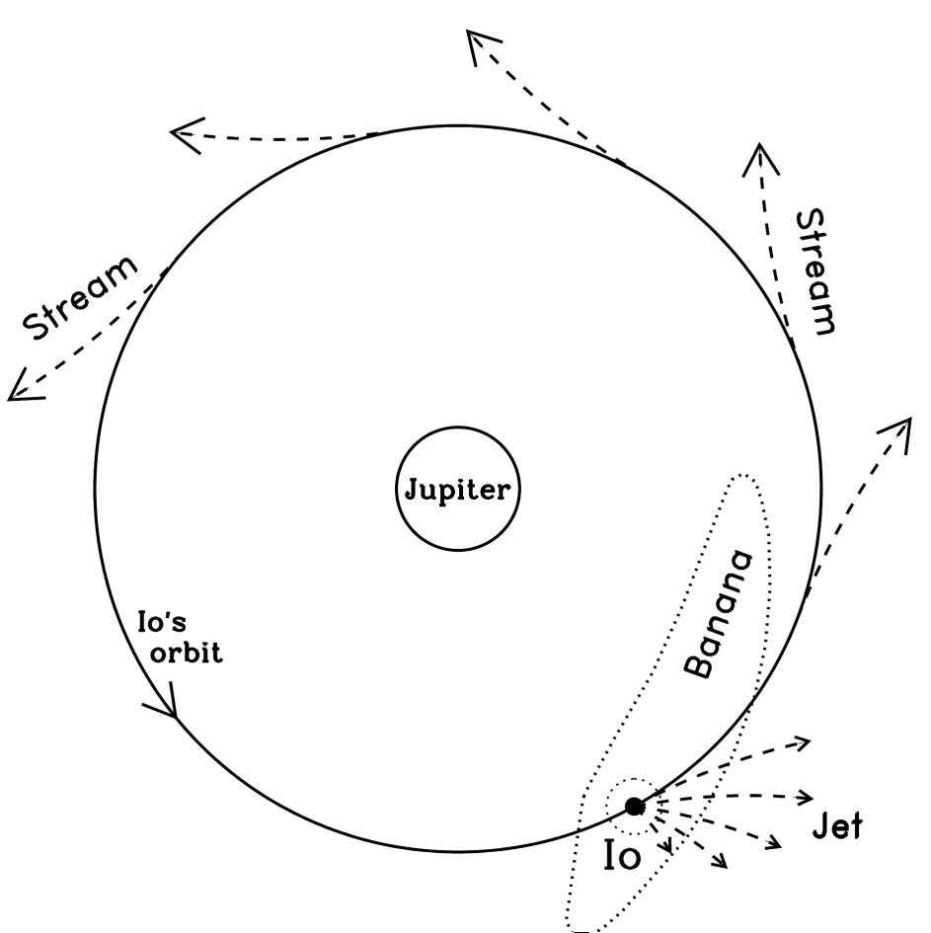
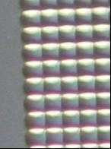
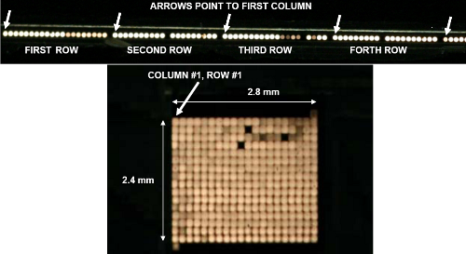

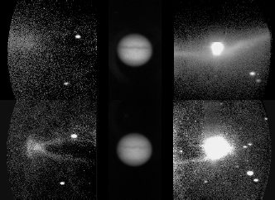
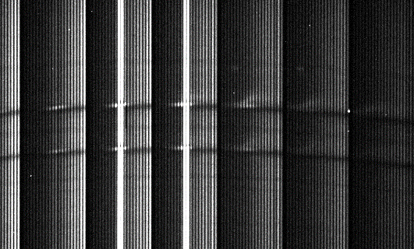
Neutral Cloud Interactions: Sodium
Low Energy
Active volcanic plume or sputtering (not sublimation)
➔ NaCl, Na
NaCl + torus ion ➔ Na + …
Hi Energy
CHEX … or NaCl + γ ➔ NaCl⁺
NaCl⁺ + e⁻ ➔ Na* + Cl
Raw Io Data
Sodium
Wilson et al. 2002
Sulfur⁺
Schneider & Trauger 1995
20 x 12 multiplexed spectra

Slide 27


Unwarped, Extracted, CRs removed
Scattered Jupiter
Io Surface Reflection
Reflection
2.8 km s⁻¹ pix⁻¹
Spectra
D₂
Io Absorption
Io Emission
dλ
Jupiter Absorption
D₁

Slide 28

Surface Reflectance Subtracted
Residual Noise
75 km / s
WRT Io
Spectra
D₂
Slow Sodium
Fast Sodium
dλ
D₁

Slide 29









Io: Sodium Spatial Reconstructions
λ_{III} CML = 358°
Instrument Field of View
λ_{III} CML = 113°

Slide 30









Escape
Io-Europa Transfer
$$V_{S}≈\frac{2π\sqrt{d_{E}^{2}−d_{I}^{2}}}{ω_{I}\left[\cos^{−1}\left({d_{I}}/{d_{E}}\right)− \left(θ_{E}−θ_{I}\right)\right]}$$
$$V_{rel}≈ \sqrt{V_{E}^{2}+V_{S}^{2}−2V_{E}V_{s}\left({d_{I}}/{d_{E}}\right)}$$
$$h≈ \sqrt{r_{E}^{2}+\frac{2r_{E}GM_{E}}{V_{rel}^{2}}}$$
$$F_{IE}≈\frac{{10}^{6}Bcos(φ)V_{rel}πh^{2}}{Zg_{s}}$$
λ_{III} dawn = 132° ΔL = 0.03
λ_{III} dawn = 294° ΔL = 0.07
Europa
Io
Ion Recombination
Sputtered Atmosphere

Slide 31




Fate of the Fast Neutral Streams

Slide 32



Sodium Nebula Volcanic Response
Active vs Quiet Periods
McDonald 10 cm
Haleakala and Hisaki EUV
Mendillo et al. (2004)
Tsuchiya, Yoneda et al.

Slide 33
Sodium Nebula Volcanic Response
Active vs Quiet Periods
Oxygen vs Sodium
Haleakala and Hisaki EUV
Koga et al. (2018)
Yoshikawa et al. (2017) Yoneda et al. (2015)
But how much O & Na enhancement is atoms vs electrons?

Slide 34

Bagenal (1994)
Johnson et al. (2009)
13.6eV
5.1eV
In electron excited lines e- and neutrals are entangled
Little known about O and S atomic clouds, but they could be more extended then Na.
Hisaki O 1356Å analysis is underway (Koga) as is Cassini O 1304Å & S 1474Å (Steffl).
Burger (PhD Thesis)

Slide 35

Oxygen
Sodium
Na
O I 6300Å
Na I 5890Å
Surface reflectance is a problem. [O I] 6300Å is faint and sensitive to n_{e-}. It’s easier to look in for extended O and S clouds in T_{e-} sensitive UV lines, since we expect T_{e-}↑ and n_{e-}↓ away from Io.
Burger (PhD Thesis)

Slide 36

Any O and S jets similar to Sodium?
Upstream of Io
Downstream of Io
Burger et al. (1999)
Cremonese et al. (1992)
Early analysis of summer 2018 HST/COS data suggests fast O jets might be present.
Jet emissions are red-shifted ~0.3Å or 60 km/s compared to black line profiles on-disk → Charge exchange not SO₂⁺

Slide 37

Lots to learn from...
Start with lines of like species to characterize the electron population.
Torus electrons fit sulfur line ratios okay, but detailed synthetic spectra needed…
More to come!
T_{e-} = 6 eV
n_{e-} = 3500 cm⁻³

Slide 38

Io Spectrum
DAWN SIDE
Wake Spectrum
Io Spectrum

Slide 39

DUSK SIDE
Wake Spectrum
Io Spectrum

Slide 40
Juno Radio Occultations of the Torus:
Radio delay time probes the total electron content latitudinally
Overlapping data from Hisaki +/- 2.5 hours probes the same plasma radially.

Slide 41
Example for Juno’s Perijove #6
-Electron scale heights
-Column density
-Cold torus vs ribbon latitudes
Example Hisaki data co-added +/- 2.5 hours before & after the torus occultation, summing 20° longitude.

Slide 42
Summary: Neutrals
Atomic collapse is longer and more variable than molecules, giving clues to dissociation rates.
NaCl⁺ largely recombines in a mass-loaded flow. Periodic neutral transfer to Europa can occur 2-3 hours past Io conjunction. ~7 x 10²² atoms / s Na implantation, probably modulated by Jovian longitude near dawn.
Distant sodium cloud brightens on the dawn-side first due the torus’ dawnward offset.
Distant oxygen clouds can be inferred via Doppler shift in recent HST spectra. Appears to be O charge exchange and not dissociative recombination of a molecular ion like the sodium jet.

Slide 43
Summary: Plasma Torus
With better constraints, torus motion is consistent with previous data, not theory. Always peaks inside Io’s L-shell.
Ribbon & cold torus motion is decoupled, predicable. Why?
E-field is highly variable 1-7 mV / m. Lower than Voyager and Galileo. Direction poorly constrained at ~ -10° LT.
Dawn-Dusk EUV asymmetry effects largely results from plasma temperatures, not densities.
Peak density is 3500-4000 cm⁻³
Cold torus T_{e}~2 eV, ~5 eV elsewhere, good evidence the ribbon is colder locally, especially at dawn (Io?).
First Io phase effect in the optical, density vs temp?
No longitudinal “active region.” Structure resembles Hisaki & prob. relates to conditions at last Io conjunction (<12.9h)

